Slide 1
Troy restaurant
Indian, Italian and Mexican Chains
Coursera Capstone - IBM
December-2020

Slide 2
INTRODUCTION
01
Initial Description
A restaurant conglomerate is considering expanding its business to Troy, Michigan. The conglomerate owns Mexican, Italian and Indian brands and, in any single lot is able to build two of the three chains sharing a single cuisine.
03
Business Question
Which brand would face the highest competition?
Are the other opened restaurants in Troy located in Roads or quieter streets?
If in Road, is there a road with less competitors?
Where are the less expensive land to start the project?
02
Target Audience
A restaurant conglomerate

Slide 3
DATA
01
FOURSQUARE
Venue data regarding the Indian, Italian and Mexican restaurants
03
TROY, MI REAL ESTATE & DEMOGRAPHIC DATA
Most affordable places to build the restaurants.
02
GEOCODER
Latitudes and longitudes

Slide 4
METHODOLOGY
01
Language, package and API
All the code is in Python written using Jupiter Notebook installed via Anaconda. The code required several packages and the following API:
Folium
Geocoder
Json
Foursquare API
02
The interaction between the three data sources will provide the necessary info to answer the business problem described in the beginning of the report. From foursquare and geocoder, it will be possible to answer questions 1-3. The last question will be responded adding the neighborhood data.
pYTHON

Slide 5
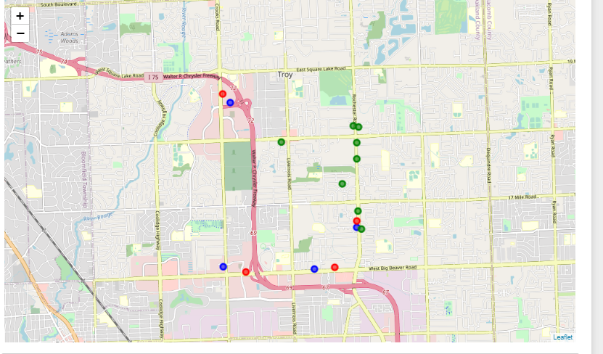
Results

Slide 6
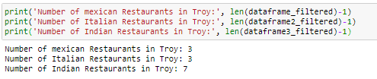
Results

Slide 7
Results
01
Business Question and Answers
Which brand would face the highest competition?
Indian
Are the other opened restaurants in Troy located in Roads or quieter streets?
Roads
If in Road, is there a road with less competitors?
Livernois Rd.
Where are the less expensive land to start the project?
South of Troy

Slide 8
References:
Foursquare Developer Documentation: https://developer.foursquare.com/docs
Latitude and Longitude of Postal codes:http://cocl.us/Geospatial_data
TROY, MI REAL ESTATE & DEMOGRAPHIC DATA: https://www.neighborhoodscout.com/mi/troy

